Slide 1
Design a menu & ordering app for a cafe
Updated version #1
17.1.2024
Team
Jana Nozickova
Presentation #2

Slide 2
Quick Recap
In the first presentation the study details, themes and insights of the App were presented. Look at the detail here: xxxxxxxxxxxxxx
Research insights and recommendation were implemented in the new prototype. Let's check it out new findings!
Research insights
no final summary before order
it is possible to order the item only from the item detail
Users like saved information in their profile
Appreciate a map or some help when adding an address

Slide 3
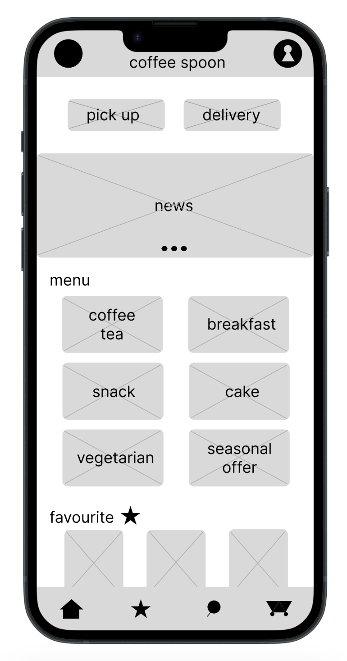

Prototype / Design Tested
Screenshot of homepage

Slide 4
Themes

Slide 5
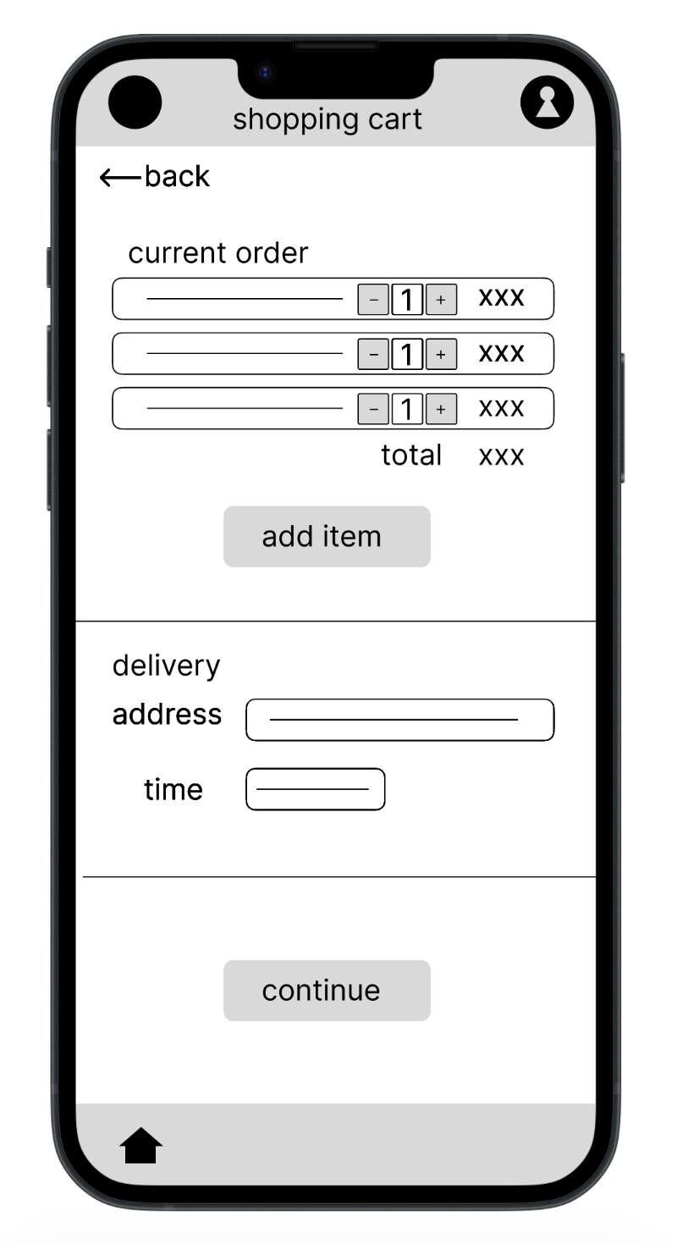
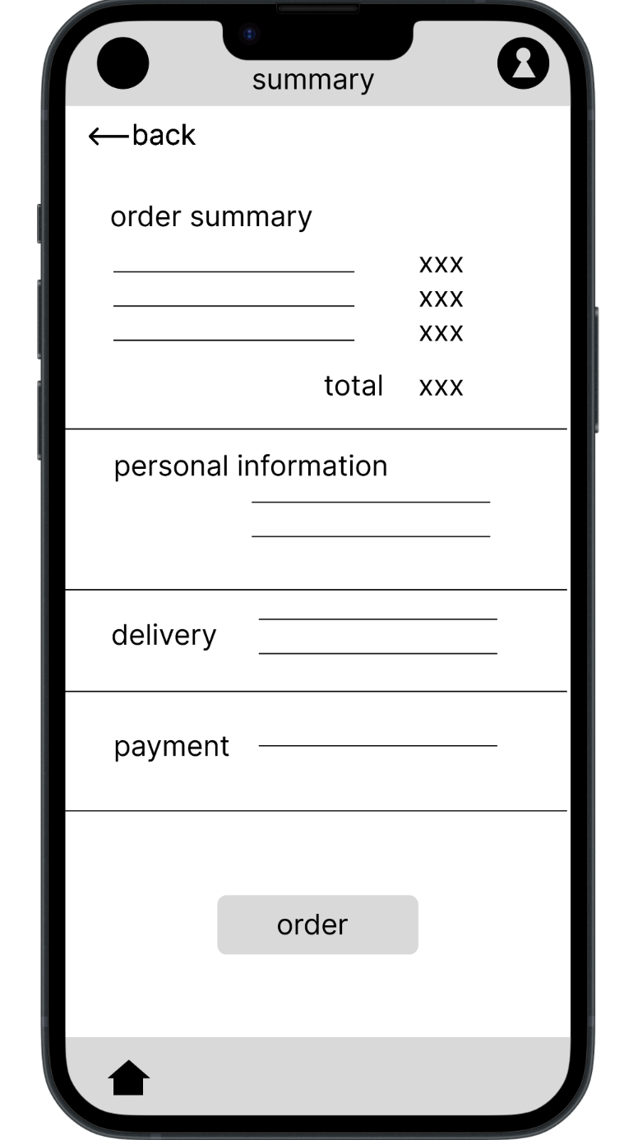
New screen
Theme #1
For most users it is important to check their order twice before ordering
4 out of 5 participants had trouble with the checkout process when there was no final summary before order.
"I expected brief summary of my order in addition, but straight away congrants screen appeared."
New screen with summarization was added

Slide 6
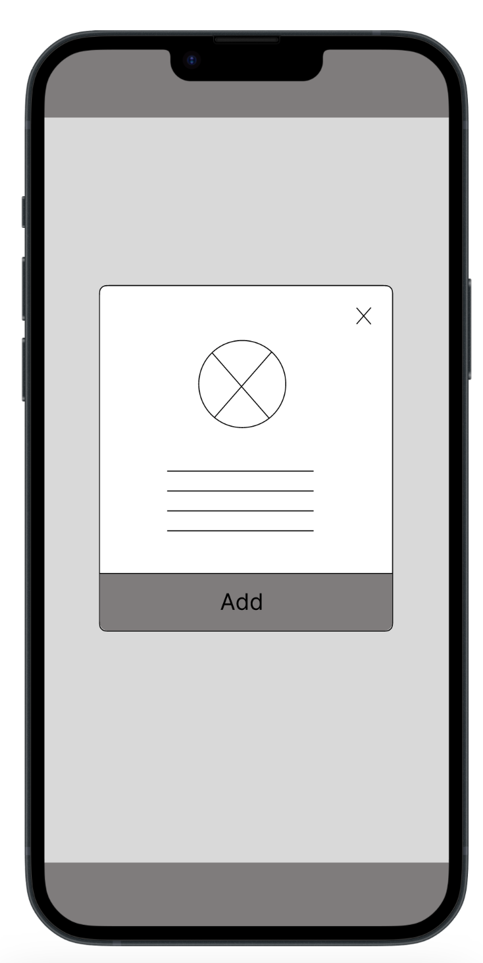
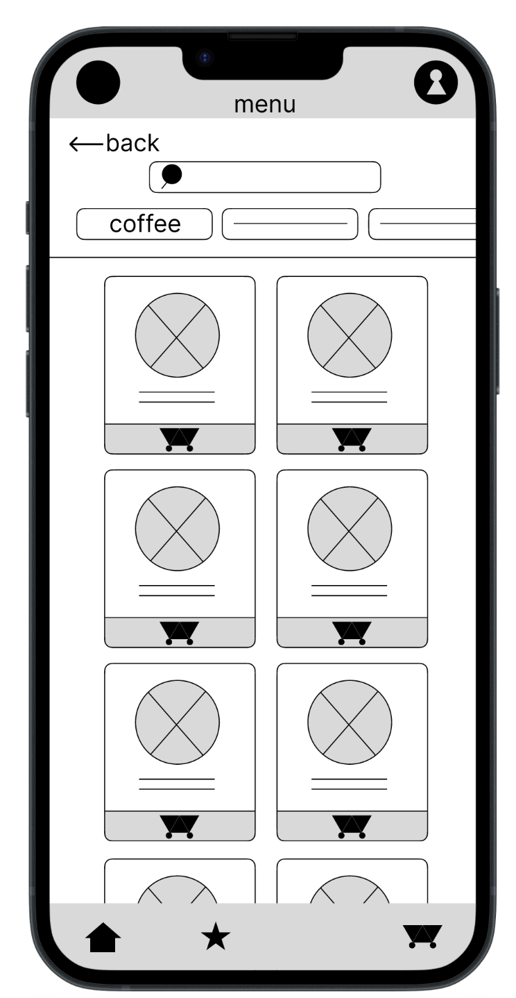
Added connections
Theme #2
Not everyone needs to display details of the item to order it.
3 out of 5 participants found difficulty in searching the menu, because it is possible to order the item only from the item detail
"Now, I do not know, what to do. I am confused. When I press the image, nothing happened. I got stuck."
New connections were added, so users can order directly from the searching menu.

Slide 7
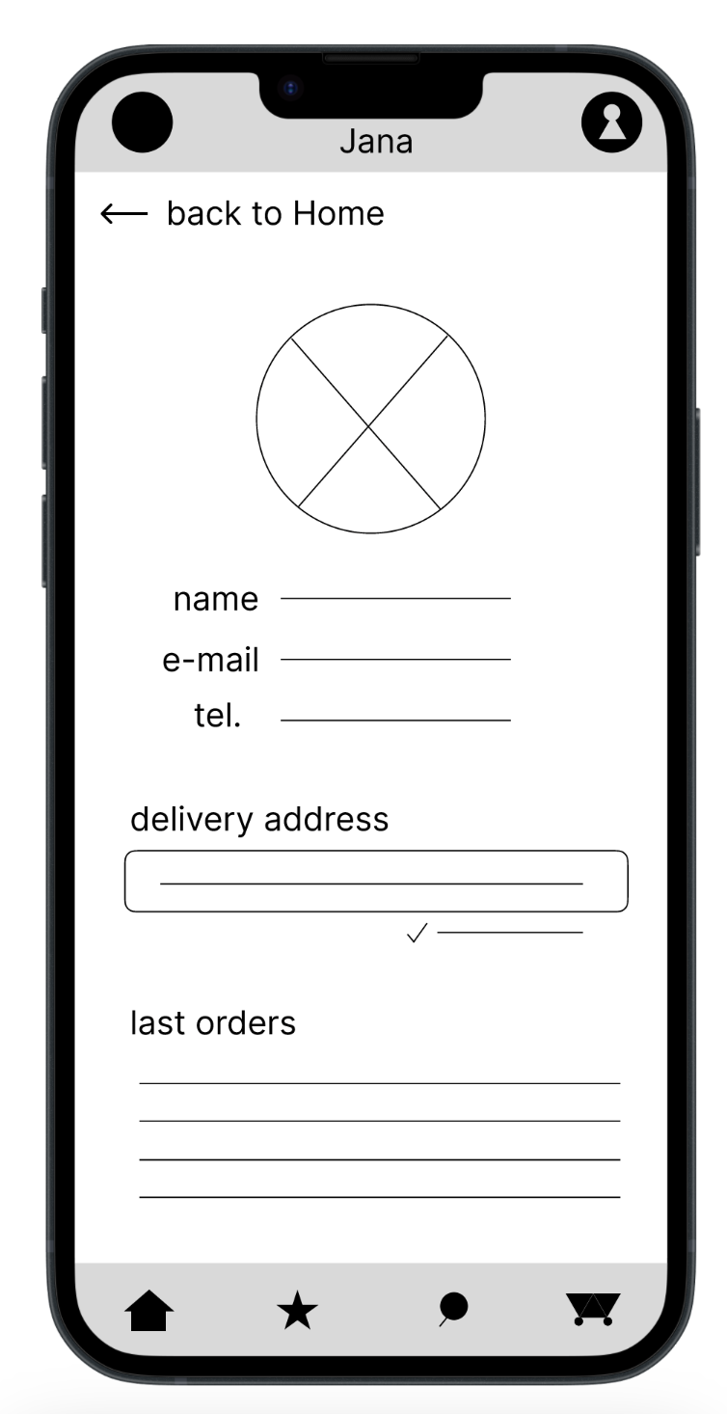
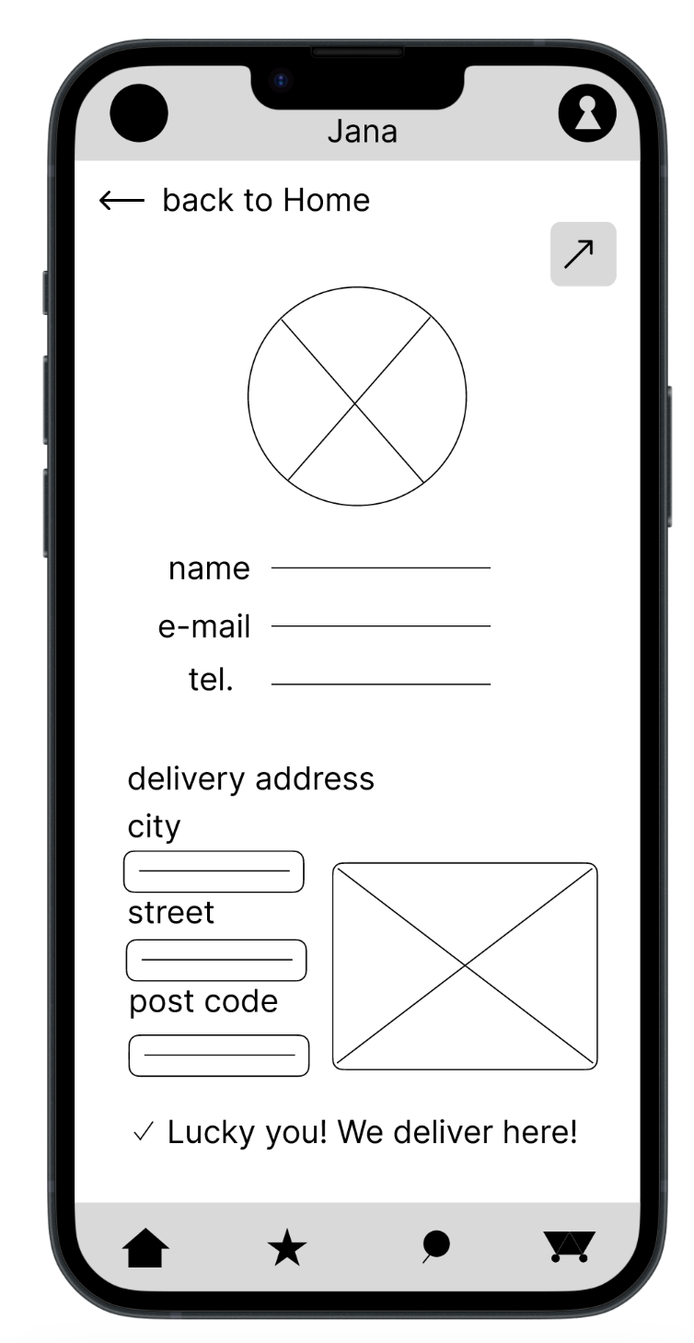
Theme #3
A few people do not need to have save details about them, but most people found it useful.
2 out of 5 participants were wondering why they need a profile created
"I think I give up, I do not need to create profile to order the coffee, I guess. Sorry."
Button for edit and save profile information was edit
a

Slide 8
Theme #4
A small sample of people finds difficulties when adding an address, but not for the majority.
2 out of 5 participants would appreciate a map or some help when adding an address
"I would appreciate opening some map, when I filling in the address."
New surroundings were implemented, so that user can insert address info more easily.
a

Slide 9
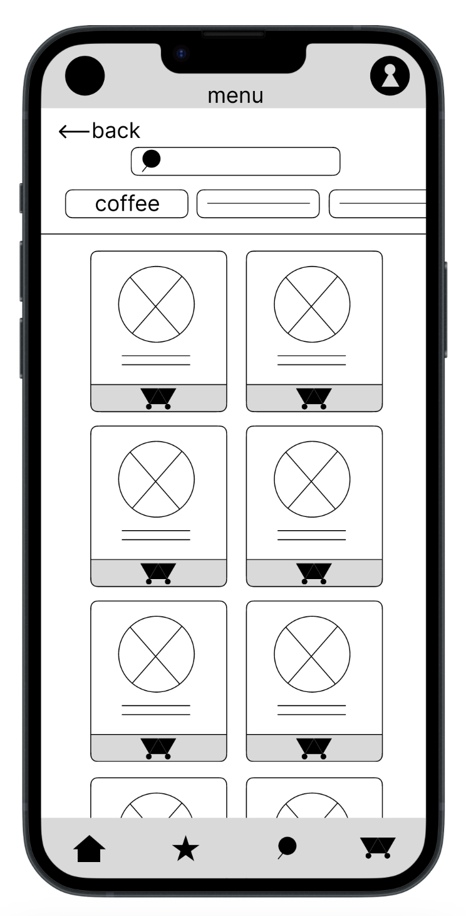
Added connections
Theme #5
For most people it is important to order coffee as easily and intuitively as possible.
4 out of 5 participants found the checkout process quick and smooth
"Yes, this is an easy App. I like it."
New connections were added, so users can order more smoothly.
a

Slide 10
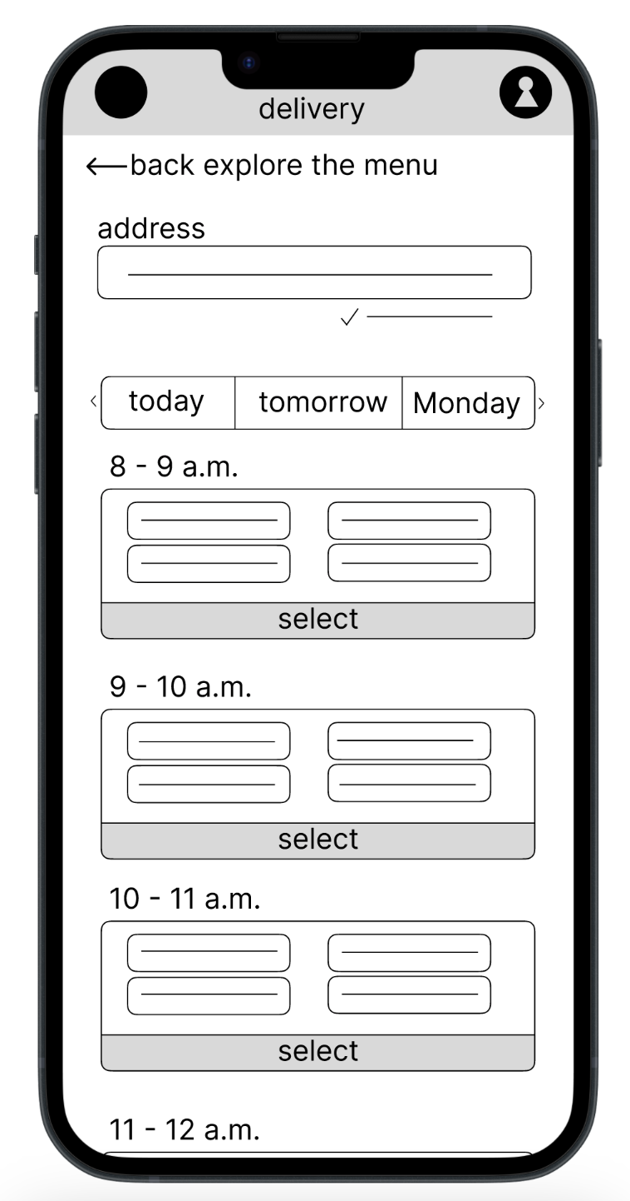
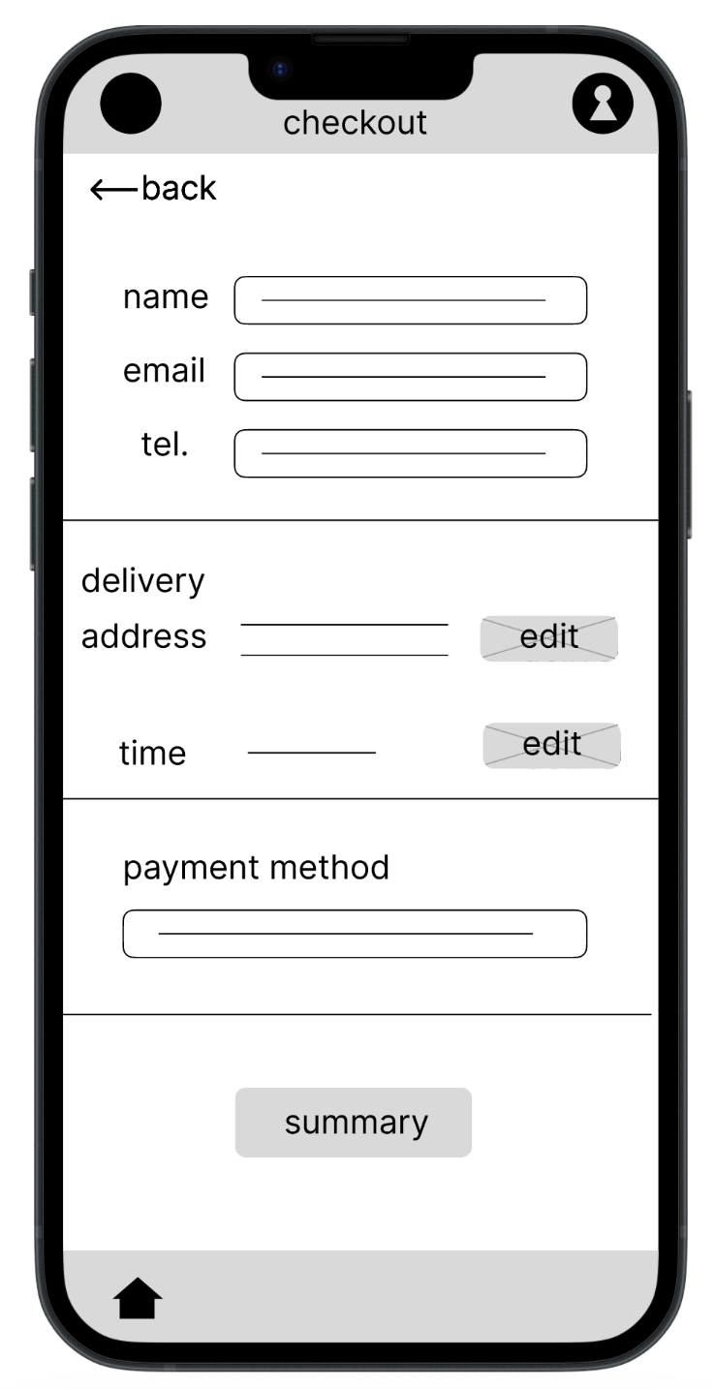
Theme #6
For most users delivery and time searching are intuitive and clear.
3 out of 5 participants appreciated the intuitive schedule of delivery and time
"I like this time schedule, very intuitive."
Nothing new happened in delivery screen, but new button Edit was added in order to change delivery time easily.
a

Slide 11
Insights & Recommendations

Slide 12
Recommendations for additional research
Additional research
additional accessibility research is recommend, as it is sometimes difficult to recruit enough users with disabilities in the first session. This can also be applied to any participants from underrepresented groups. Additional research might be helpful.
Next steps / Recommendations
1 realize new accessibility research with another group of users
2 analyze the research, if some issue with priority P0 or P1 is needed to implement
3 analyze and summarize data from the research

Slide 13
Thank you!

